Slide 1
Java Servlets 3.0
Lesson 02: Introduction to Servlets API
and Ease of Development through
Annotations
Notes:
Add instructor notes here.

Slide 2
Lesson Objectives
In this lesson, we will learn:
Introduction to Servlet
Role of Servlets in Web application design
Advantages of Servlets
Basic Servlet Architecture : Servlet Container
Servlet Lifecycle
Ease of Developing Servlets through Annotations
Retrieving Information from HTML Page
Notes:
Lesson Objectives:
This lesson introduces Servlets 3.0 and ease of development through Annotations , The lesson contents are:
3.1: Introduction to Servlet
3.2: Role of Servlets in Web Application Design
3.3: Advantages of Servlets
3.4: Basic Servlet Architecture: Servlet Container
3.5: Servlet Lifecycle
3.6: Ease of Developing Servlets through Annotations
3.7: Retrieving Information
Explain the lesson coverage

Slide 3
2.1: Introduction to Servlet What are Servlets?
Servlets are Java programs that extend the functionality of a Web server and capable of generating a dynamic response to a particular request using the HTTP Request / Response paradigm
Servlets are not tied to a specific client-server protocol but they are most commonly used with HTTP and the word “Servlet” is often used in the meaning of “HTTP Servlet”
It is available and runs on all major web and application servers
It is platform and server independent
Notes:
Introduction to Servlet:
Java servlets are a key component of server-side Java Development. Servlets are modules of Java code that run in a server application to answer client requests. These are small, pluggable extensions to server that enhance the server’s functionality. Servlets allow developers to extend and customize any Java-enabled server.
When servlets are used to generate dynamic content for a web page or otherwise extend the functionality of a web server, is like creating a web application!
Since servlets are written in the highly portable Java language and follow a standard framework, they provide a means to create sophisticated server extensions in a server and operating system independent way.
Although servlets can respond to any type of request, they are commonly used to extend the applications hosted by web servers. For such applications, Java Servlet technology defines HTTP-specific servlet classes. We shall see more on this in the coming sections.
Servlets first came on the scene around 1997. As of March 26 2010, the current version of the servlet specification is 3.0. The minimum platform requirement for Servlet 3.0 is JDK 1.6.

Slide 4
2.2: Role of Servlets in Web Application Design What Can Servlets Do?
Servlets can do the following functions:
Dynamically build and return an HTML file based on nature of client request
Process user input passed in an HTML form and return an appropriate response
Provide user authentication and other security mechanisms
Interact with server resources such as databases, other applications and network files to return useful information to the client
Automatically attach web page design elements such as headers or footers, to all pages returned by server
Forward requests from one server to another for load balancing purpose
Manage state information on top of the stateless HTTP
Notes:
Role of Servlets in Web Application Design:
Servlets can read explicit data sent in by the client in browser. This data can come from an HTML page into which user has entered data. Servlets can also read implicit request data which is sent by browser as part of request header.
Servlets can dynamically generate response and send content back to client. This process may involve talking to databases, executing another server-side component, and so on.
The response sent can be in from of pure HTML, plain text, XML, GIF images, or even as compressed data.
Explain each of these points with an example.
Example, for point #1 : based on book search, all books related to a particular category – say “Java” are returned in a neat tabular fashion
Point # 2: For a registration form, user is sent an appropriate message like “successfully registered!” on successful registration.
Point #3: Some kind of login servlet that authenticate user before providing access to any other resources on the web site
Point# 4 : A search for a particular book, say servlets, will return a list of books from some database at server side…

Slide 5
2.3: Advantages of Servlets Advantages of Servlets
Servlets provide the following advantages:
Crash Resistance
Cross-Platform
Cross-Server
Durable
Dynamically Loadable across the Network
Extensible
Multithreaded
Protocol Independent
Secure
Notes:
Advantages of Servlets over CGI:
Servlets provide the following advantages:
Compiled: Servlets are compiled into Java byte-codes. This improves performance through compile-time code optimization. Server-side JIT compilers dramatically improve the performance of JVM.
Compilation also offers the advantages of strong error and type checking. Since many errors are flushed out during the compilation, servlets are more stable and easier to develop and debug.
Crash Resistance: The JVM does not allow servlets direct access to memory locations, thereby eliminating crashes that results from invalid memory accesses. In addition, before execution, the JVM verifies that compiled Java class files are valid and do not perform illegal operations. Finally, rather than crashing, the JVM will propagate an exception up the calling chain until it is caught. Thus, a poorly written or malicious servlet cannot crash the server.
Cross-Platform: Since servlets are written in Java, they enjoy the same cross platform support as any program. This “write once, run anywhere” capability allows servlets to be easily distributed throughout the enterprise without rewriting for each platform.
Cross-Server: Servlets can be run on virtually every popular web server that is in use today. More than a dozen software vendors currently provide native support for servlets within their products. For those servers that do not currently offer native servlet support, there are many third party add-ons that allow these servers to load and run servlets.
Explain these points. Mention that Servlets being Java programs, all advantages of Java are applicable to Servlets too.

Slide 6
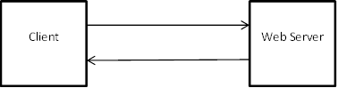
2.4: Basic Servlet Architecture : Servlet Container Servlet Container
What is a Web Server?
To know what is a Servlet container we need to know what is a Web Server first
A web server uses HTTP protocol to transfer data. In a simple situation, a user types in a URL (e.g. www.servletdemos.com/static.html) in browser (a client), and get a web page to read. So what the server does is sending a web page to the client. The transformation is in HTTP protocol which specifies the format of request and response message.
HTTP Request
HTTP Response
Notes:
Since we using WildFly 8.x which is an Application server which will host the Servlet Container to handle the web components.
We could also use the Web server for the same purpose.
Since HTTP is a web oriented protocol, thus we have taken the term to be as “Web Server”

Slide 7
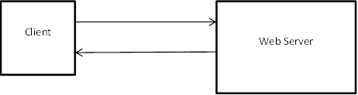
2.4: Basic Servlet Architecture : Servlet Container Servlet Container / Servlet Engine / Web Container
What is a Servlet Container / Servlet Engine / Web Container
Client can request only static web page from Server. If client wants to read Web page based upon input (that requires processing), basic idea of servlet container is to dynamically generate the Web page on the server side
Servlet container is essentially a part of a web server that interacts with the servlets. Servlet Container is container for servlets
HTTP Request
HTTP Response
Servlet Container
Notes:
When a request is sent, it is handled by the web server. If response is available within the web server it will be returned by the server to the client.
If response is not available and requires some processing then request will be processed by the Web Container.
The web container will then process the request and handover the response back to web server. The web server will then handover response back to client.
The web container delegates the request processing to web components like Servlets and JSP.
For example: If we request for a page as www.gmail.com , then same page is returned as response for all users. This is a static content
Whereas after entering your login credentials respective inbox details per user is retrieved as a response. This is dynamic content

Slide 8
2.4: Basic Servlet Architecture : Servlet Container Servlet Container / Servlet Engine / Web Container
Advantages of Servlet Container
Providing communication support between Web Components and Web Server
Life cycle support for Web Components
Networking support
Enabling Web Security
Multi threading support for Web Components
Notes:
Providing communication support between Web Components and Web Server: Servlet as a web component does not communicate
with Web Server directly. All the communication happens via Web container
Life cycle support for Web Components: Life cycle of Web components (Servlets and JSP) is managed by the container
Networking support: Web components do not need to open network and socket connections all is taken care by Web server
Enabling Web Security: Access to Web components can be secured by granting privileges.
Multi Threading support: Web components are multi-thread, for every request there is one thread generated. Thus all threads are managed by container. We do not need to do explicit multi-threading.

Slide 9
2.4: Basic Servlet Architecture : Servlet API Servlet API
A servlet is an instance of a class which implements the javax.servlet.Servlet interface.
Servlet is web component inside Servlet Container
Most servlets extend one of the standard implementations of that interface, namely javax.servlet.GenericServlet or javax.servlet.http.HttpServlet.
In Servlet 3.0, there is javax.servlet.annotation package for creating servlets via annotations
Servlet
GenericServlet
HTTPServlet
MyServlet
Notes:
Basic Servlet Architecture:
Servlet API:
Servlets use classes and interfaces from three packages: javax.servlet, javax.servlet.http.
A Servlet, in its most general form, is an instance of a class which implements the javax.servlet.Servlet interface. Most Servlets extend one of the standard implementations of that interface, namely javax.servlet.GenericServlet and javax.servlet.http.HttpServlet.
As of Servlet 3.0, make use of package javax.servlet.annotation to create Servlets.
A protocol-independent servlet should subclass GenericServlet, while an HTTP servlet should subclass HTTPServlet, which is itself a subclass of GenericServlet! (refer to the above figure).
Notice that the classes do not belong to the core Java API. They are extensions to the core API and hence javax!
Explain the Servlet hierarchy.
Explain how a protocol independent servlet can extend the functionality of any type of server including Web server, mail server etc

Slide 10
2.4: Basic Servlet Architecture : Servlet API Servlet Interface Life Cycle Methods
init():
It is executed once when the servlet is first loaded.
service():
It is called in a new thread by server for each request.
destroy():
It is called when server deletes servlet instance.
These lifecycle methods are implemented in GenericServlet class.
Notes:
Basic Servlet Architecture:
Servlet Interface Life Cycle Methods:
The Servlet interface defines methods to initialize a servlet, to service requests, and to remove a servlet from the server. These are known as life-cycle methods and are called in the following sequence:
The init() method is guaranteed to be called only once during the Servlet’s lifecycle. The Servlet performs one-time setup configurations in this method. It stores the ServletConfig[*] object so that it can be retrieved later by calling the Servlet’s getServletConfig() method (This is handled by GenericServlet). The ServletConfig object contains Servlet parameters and a reference to the Servlet’s ServletContext[*].
service() method gets called every time a new request comes in. The method is called concurrently (that is, multiple threads may call this method at the same time) so it should be implemented in a thread-safe manner.
When servlet needs to be unloaded (for example: since a new version should be loaded or the server is shutting down), the destroy() method is called. This method too is guaranteed to be called only once during the Servlet’s lifecycle. All resources which were allocated in init() should be released in destroy().
We shall be covering entire lifecycle of a typical servlet in the next section.
[*] : The ServletConfig and ServletContext interfaces are explained in the next slide.
Explain the lifecycle methods. Concept of dispatching doXXX() methods which is done by server methods must be explained to participants in depth,
Thereby highlight the consequence of overriding service method

Slide 11
2.4: Basic Servlet Architecture : Request Processing Steps to process a Request
Web server receives HTTP request
Web server forwards the request to servlet container
The servlet is dynamically retrieved and loaded into the address space of the container, if it is not in the container
The container invokes the init() method of the servlet for initialization(invoked once when the servlet is loaded first time)
The container invokes the service() method of the servlet to process the HTTP request, i.e., read data in the request and formulate a response. The servlet remains in the container’s address space and can process other HTTP requests
Web server return the dynamically generated results to the client
Notes:
From the life cycle of a servlet object, we can see that servlet classes are loaded to container by class loader dynamically. Each request is in its own thread, and a servlet object can serve multiple threads at the same time. When it is no longer being used, it should be garbage collected by JVM.
Like any Java program, the servlet runs within a JVM. To handle the complexity of HTTP requests, the servlet container comes in. The servlet container is responsible for servlets’ creation, execution and destruction.
Explain the lifecycle of processing a request

Slide 12
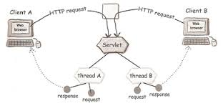
2.4: Basic Servlet Architecture : Request Processing How Container handles a request
Notes:
Every request coming to the container from the client for a particular servlet will be treated as a separate thread.
Each thread will have its own copy of the request / response objects.
After the processing of a particular request is completed the threads would be garbage collected. But the servlet instance would still be there in memory.
Thus for processing multiple requests multiple threads are created.
Explain the lifecycle of processing a request

Slide 13
2.4: Basic Servlet Architecture : Hierarchy GenericServlet class
javax.servlet.GenericServlet
It is protocol independent
It makes writing servlets easier
It provides simple versions of init() and destroy() and of the methods in the ServletConfig interface.
It also implements the log method, declared in the ServletContext interface.
To write a generic servlet, override the abstract service().
Web
Server
GenericServlet
subclass
request
response
service()
Notes:
Basic Servlet Architecture:
GenericServlet:
All the lifecycle methods are implemented in GenericServlet class. Thus if GenericServlet class is extended to create a servlet, all the methods may be overridden to provide implementations. Optionally, just override the service() method to handle the request in the manner required!
ServletContext interface :
It defines a set of methods that a servlet uses to communicate with its servlet container, for example, to get the MIME type of a file, dispatch requests, or write to a log file.
There is one context per “web application” per JVM.
ServletContext attributes can be used to share information among a group of servlets.
The ServletContext object is contained within the ServletConfig object, which the Web server provides the servlet when the servlet is initialized.
ServletConfig interface:
This is a servlet configuration object used by a servlet container used to pass information to a servlet during initialization.
It is implemented by GenericServlet.
All of its initialization parameters can be set in deployment descriptor. Or else they can be passed via annotations. The ServletConfig parameters are specified for a particular servlet and are unknown to other servlets.
ServletContext and ServletConfig will be discussed in later sessions.
Explain the GenericServlet
Explain the figure.
Also explain about ServletConfig and ServletContext interfaces

Slide 14
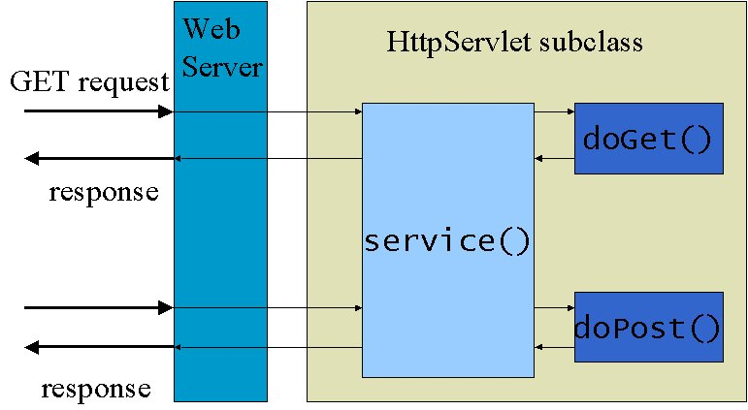
2.4: Basic Servlet Architecture : Hierarchy HttpServlet class
javax.servlet.http.HttpServlet:
It has a built-in HTTP protocol support.
Its subclass must override at least one of the following methods: doGet(), doPost(), doHead(), doTrace(), doPut(), doDelete()
One must not override the service() method, since it dispatches a request to the different doXXX() methods for different HTTP requests.
Notes:
Basic Servlet Architecture:
HttpServlet:
init() and destroy() can be overridden to manage resources that are held for the life of the servlet. Servlet can implement getServletInfo() to provide information about itself.
The service() method of HttpServlet dispatches a request to different Java methods for different HTTP request methods. It recognizes the standard HTTP/1.1 methods like GET, HEAD, PUT, POST, DELETE, OPTIONS and TRACE. Other methods are answered with a Bad Request HTTP error.
Do not override the service() method because it handles setup and dispatching to all the doXXX() methods. Since service() method dispatches to doXXX() methods, it passes its request and response objects to these methods.
An HTTP servlet generally overrides doGet() to handle GET requests and doPost() to handle POST type of requests.
Explain the figure and compare it vis-à-vis generic servlet

Slide 15
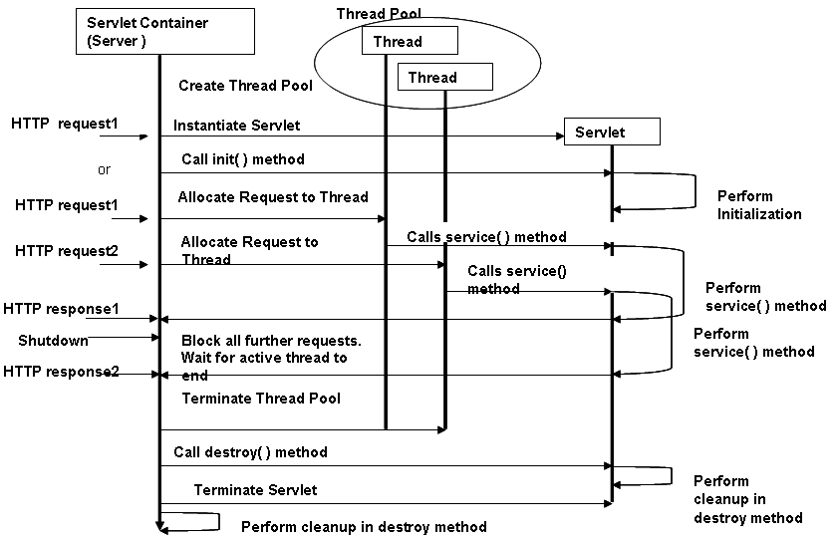
2.5 : Servlet lifecycle Servlet Life Cycle
Notes:
Basic Servlet Architecture:
Servlet Life Cycle:
The process by which a server invokes a servlet can be broken down into the nine steps described below and as shown in the figure in the above slide:
The server loads the servlet when the client first requests it or, if configured to do so, at server start-up. The servlet may be loaded from either a local or remote location using the standard Java class loading facility. This step is equivalent to the following code: Class c= Class.forName(“com.igate.Myservlet”);
The server creates one or more instances of the servlet class. Depending on the implementation, the server may create a single instance that services all requests through multiple threads or create a pool of instances from which one is chosen to service each new request. This step is equivalent to the following Java code: Servlet s= (Servlet) c.newInstance();
The server constructs a ServletConfig object that provides initialization information to the servlet.
The server calls the servlet’s init(ServletConfig cfg) method. The init() method is guaranteed to finish execution prior to the servlet processing the first request. If the server created multiple servlets instances (step 2), then the init method is called one time for each instance.
Explain the sequence diagram about the life cycle of Servlets

Slide 16
2.6: Ease of developing Servlets through Annotations Annotations and their Need
Annotations can be described as metadata. These are metadata for the code written; and do not contain any business logic
They specify a standard way of defining metadata in code
Annotations are tightly coupled with the code
Application development becomes easy due to annotations
Notes:
Why Were Annotations Introduced?
Prior to annotation (and even after) XML were extensively used for metadata and somehow a particular set of Application Developers and Architects thought XML maintenance was getting troublesome. They wanted something which could be coupled closely with code instead of XML which is very loosely coupled (in some cases almost separate) from code. Interesting point is XML configurations were introduced to separate configuration from code.
Suppose, you want to set some application wide constants/parameters. In this scenario, XML would be a better choice because this is not related with any specific piece of code. If you want to expose some method as a service, annotation would be a better choice as it needs to be tightly coupled with that method and developer of the method must be aware of this.
Another important factor is that annotation defines a standard way of defining metadata in code. Prior to annotations people also used their own ways to define metadata. Some examples are – using marker interfaces, comments, transient keywords etc. Each developer decided his own way to decide metadata, but annotation standardized things.
These days most frameworks use combination of both XML and Annotations to leverage positive aspects of both.

Slide 17
2.6: Ease of developing Servlets through Annotations Differences between Servlets 2.0 and Servlets 3.0
Servlet 2.0 | Servlets 3.0
Creation of Servlets and other components via XML mappings | Creation of Servlets and other components via annotations
No such feature | Pluggability support for 3rd party frameworks
No such feature | Asynchronous processing of Servlets
Notes:
Pluggability Support for 3rd Party frameworks and Asynchronous processing of Servlets - details of which are shared in the Appendix.
Creation of Servlets and other components via XML mappings – details of which are shared in the Appendix.
In the subsequent slides we would be seeing creation of Servlets and other components via annotations.

Slide 18
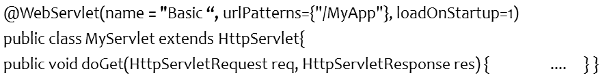
2.6: Ease of developing Servlets through Annotations URL Mapping of Servlets and Annotations
@WebServlet Annotation: javax.servlet.annotation.WebServlet is a class-level annotation that affirms the annotated class as a servlet and holds metadata about the declared servlet
The urlMappings attribute is a mandatory attribute of @WebServlet that specifies the URL pattern that invokes this servlet
Here is the much simplified version written to the Servlet 3.0 API.
As MyServlet is annotated as a servlet using the @WebServlet annotation, it gets initialized during the startup of the web container. Note that the deployment descriptor is optional in this case.
Notes:
When a request arrives, the container matches the URL in the request with the servlet's URL Patterns and if the URL pattern matches, the corresponding servlet will be invoked to serve the request. All other attributes of this annotation are optional, with reasonable defaults.
The name attribute specifies the name of servlet. It could be different from Servlet class, URL Pattern. Rather is just a dummy name given to servlets. This attribute is not mandatory.
It also has loadOnStartup attribute, this is used to specify - If you want to do something on the startup of the servlet (i.e. the element loadOnStartup with value greater or equal to zero, 0), you need put the code in a init method or in the constructor of the servlet: As we know the init() method is the first life cycle method of servlet.
loadOnStartup also specifies that it will be the first servlet to execute before the client request comes for the servlet and the init() method would run.
For comparison, a code snippet for writing a Java servlet using the old Servlet 2.5 API is shown below. In Servlet 2.5, the web container will initialize the servlet only if you configure the details of the servlet in the deployment descriptor
public class MyServlet extends HttpServlet {
public void doGet (HttpServletRequest req, HttpServletResponse res)
{ ....
}
}
Deployment descriptor (web.xml)
<web-app>
<servlet>
<servlet-name>MyServlet</servlet-name>
<servlet-class>samples.MyServlet</servlet-class>
</servlet>
<servlet-mapping>
<servlet-name>MyServlet</servlet-name>
<url-pattern>/MyApp</url-pattern>
</servlet-mapping>
</web-app>
Mention about the @WebServlet annotation, and its various attributes. Also specify about importance of loadOnStartup element.

Slide 19
2.6: Ease of developing Servlets through Annotations Writing First Servlet
import java.io.*;
import javax.servlet.*;
import javax.servlet.http.*;
import javax.servlet.annotation.WebServlet;
@WebServlet("/HelloWorld")
public class HelloWorld extends HttpServlet {
protected void doGet(HttpServletRequest request,
HttpServletResponse response) throws ServletException, IOException {
response.setContentType("text/html");
PrintWriter out = response.getWriter();
out.println("<HTML>");
out.println("<HEAD><TITLE>Hello World</TITLE></HEAD>");
out.println("<BODY>");
out.println("<BIG>Hello World</BIG>");
out.println("</BODY></HTML>");
}
}
Servlets are not part of standard SDK, they are part of j2ee
Use of @WebServlet annotaion
Servlets normally extend HttpServlet
Setting the response type
Getting PrintWriter object to send response to client
Output to the client
Notes:
Elements of a Web Application:
The above servlet prints a simple hello world.
This code snippet is using @WebServlet annotation.
Here the URL pattern mapping is embedded within the same annotation. The class also extends HttpServlet and overrides the doGet(request, response) method.
Make use of the annotation @WebServlet above the class name which will create the servlet – HelloWorld inside the container. The servlet will now be referred by the name “HelloWorld”. The “/HelloWorld” is the URL Pattern of servlet, that would be used to invoke servlet from web browser.
URL pattern could be any logical name example: “/Hello”. It need not be necessarily same name of Servlet. A servlet could have multiple URL patterns.
The doGet() method is overridden to service all incoming requests. Line 8 uses HttpServletResponse object to set the content type of the response. Line 9 uses the response object to retrieve a PrintWriter object to send responses. The remaining lines dynamically generate the HTTP response back to the browser client!
Following are minimum steps needed to create any servlet:
Write servlet
Import the necessary Java packages.
Inherit from GenericServlet or the HTTP convenience class HttpServlet.
Override the service method or the doXXX() methods.
Save the file with a .java filename extension.
2. Deploy the servlet in a container. The process for deploying (installing) a servlet into a webserver (container) varies from webserver to webserver.
Test the servlet by invoking the servlet from a JDK1.8-compatible browser. The URL typically will be of the form:
http://host_name:port/servletcontext/servlet/servlet_class_name
For example: http://localhost:9090/WildFlyServletsTestDemo/HelloWorld, where WildFlyServletsTestDemo is the context root and HelloWorld is the name of the servlet.
If the server is installed on the same machine as the browser, then the server name can also be referred to as localhost.
Explain what is deploying a servlet in a container

Slide 20
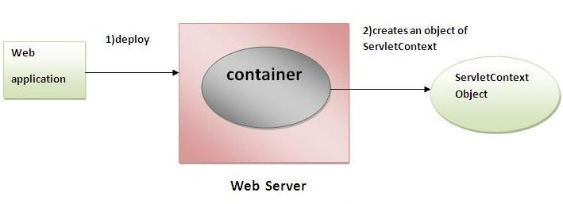
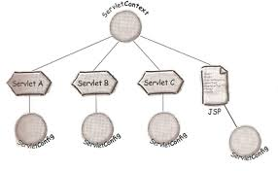
2.7: Servlet Configuration ServletContext / ServletConfig Interfaces
Notes:
The Container is responsible for creating the ServletContext object when the application gets deployed. ServletContext Object can be shared among multiple web components.
ServletConfig object will be created by the container for every servlet. This object cannot be shared between multiple web components.
More on these interfaces in the next subsequent slides
Explain the concept of a Listener.
Especially, the ServletContext Listener

Slide 21
2.7: Servlet Configuration Servlet Context Listener
Implementations of this interface receive notifications about changes to the servlet context of the web application they are part of. To receive notification events, the implementation class must be annotated with @WebListener annotation
Servlet Context Listener will be used to set the context parameters that would be shared by the entire web application
As Servlet Context is created when application is deployed the listener will execute the lifecycle methods that is contextCreated(ServletContextEvent) and contextDestroyed(ServletContextEvent) in background
ServletContext object could be obtained via the ServletContextEvent object and then the contextual parameters can be set inside the ServletContext object.
Notes:
ServletContextListener is a listener which would get notified for the changes in the ServletContext once the ServletContext object gets created.
As ServletContext is created per Web application , data can be configured in listener which can be shared throughout the application.
Once the Listener is implemented need to override the life cycle methods as contextCreated() and contextDestroyed(), each of them taking a parameter of type ServletContextEvent; this object can be used to obtain the ServletContext object. (ServletContextEvent.getServletContext())
Refer below listing to have an idea about the Listener:
@WebListener
public class TestServletContextListener implements ServletContextListener {
public void contextDestroyed(ServletContextEvent sc) {
}
public void contextInitialized(ServletContextEvent sc) {
}
}
Explain the concept of a Listener.
Especially, the ServletContext Listenr

Slide 22
2.7: Servlet Configuration and Accessing Initial Parameters via Annotations Initializing Servlets: Init Parameters / Context Parameters
When Servlets’ first lifecycle method – init() is invoked by the container, two objects are handed over to servlet
ServletConfig
To pass certain configuration information to servlet
ServletConfig is per servlet and cannot be shared between servlets
ServletConfig is available from init() method onwards. It is also available in service() method.
ServletConfig object could be obtained via: getServletConfig() method, which is inherited from GenericServlet class
Demo: ServletConfiguration.java
Notes:
There are 2 versions of init:
init()
init(ServletConfig config)
Both these methods could be overridden. If we override parameterized version of init(ServletConfig config) there is a need to give a call explicitly to
super.init(config). By seeing this call the container would invoke the parameterized init() from the GenericServlet hierarchy and then give a call for the default version of init() handing over the ServletConfig and ServletContext objects.
Even if we override default version of init(), the container would still invoke the parameterized init(ServletConfig config) from the GenericServlet hierarchy and then give a call for the default version of init() handing over the ServletConfig and ServletContext objects.
This is due to Servlet Hierarchy discussed in previous slides.
Since Servlet 3.0 we have made use of annotation to declare init parameter. Example: @WebInitParam(name = "name", value = "My Servlet")
For Servlet Context parameters, there is a need to configure a Listener : ServletContextListener – which will implement the lifecycle methods of ServletContext.
And then the contextual parameters could be set.
Refer Demo TestServletContextListener.java for same.
The context parameters could be then retrieved inside a servlet.

Slide 23
2.7: Retrieving information from HTML Page Retrieving Information
Many a times, information about the environment in which a web application is running needs to known.
Sometimes information about the server that is executing servlets or which client is sending the request needs to be known.
Sometimes information regarding the requests that the application is handling is required to be known
We shall now see a number of methods that provide this information to servlets
Notes:
In the Servlet Hierarchy, there is a Listener associated with different objects like ServletContext, HttpSession etc; that would be invoked when these objects are created.
A Listener is a java class that would implement the ServletContextListener interface and would implement the lifecycle methods of ServletContext:
contextInitilized(ServletContextEvent se)
contextDestroyed(ServletContextEvent se)
We are using the annotation @WebListener above the Listener class name that would instruct the container to create the ServletContextListener and invoked it when a ServletContext object is created by Container, Data or configuration information that needs to be shared across multiple servlets could be set up in the ServletContext here. ServletContext is obtained via the ServletContextEvent.getServletContext() method.

Slide 24
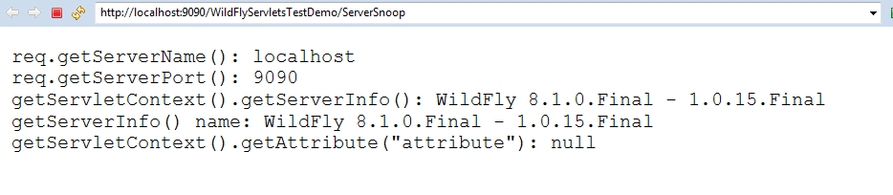
2.7: Retrieving information from HTML Page Getting Information about the Server
There are four methods that a servlet can use to learn about its server:
These are as follows:
public String ServletRequest.getServerName()
public String ServletRequest.getServerPort()
public String ServletContext.getServerInfo()
public String ServletRequest.getAttribute( String name)
Notes:
Retrieving Information:
Getting Information about the Server:
A servlet can find out much about the server in which it is executing. It can learn the hostname, listening port, and server software, among other things. A servlet can display this information to a client, use it to customize its behavior based on a particular server package, or even use it to explicitly restrict the machine on which the servlet will run.
getServerName() method returns the host name of the server to which the request was sent.
getServerPort() method returns the port number to which the request was sent
getServerInfo() method returns the name and version of the server software as: JBossWeb/2.0.1.GA.
getAttribute() returns the value of the named server attribute as an Object or null if the attribute does not exist. The attributes are server dependent. We shall see this in detail in the session on inter-servlet communication.
The last method (getAttribute()) may not be understood at this point. Inform participants that this method will be covered in detail later

Slide 25
2.7: Retrieving information from HTML Page Getting Info about client m/c and user
Getting Information about client machine:
public String ServletRequest.getRemoteAddr(): It retrieves the IP address of the client machine.
public String ServletRequest.getRemoteHost(): It retrieves the hostname of the client machine.
Getting Information about User:
public String HttpServletRequest.getRemoteUser(): It returns the login of the user, if the user has been authenticated, or null if not.
Notes:
Retrieving Information:
Getting Info About client m/c and user:
A servlet has the ability to find out about the client machine and for pages requiring authentication, about the actual user. This information can be used for logging access data, associating information with individual users, or restricting access to certain clients.
A servlet can use getRemoteAddr() and getRemoteHost() to retrieve the IP address and hostname of the client machine, respectively.
The information comes from the socket that connects the server to the client, so the remote address and hostname may be that of a proxy server. An example remote address might be “192.26.80.1320” while an example of remote host might be “dist.engr.com”.
The method getRemoteUser () of the HttpServletRequest gives the username of the client. With the remote user’s name, a servlet can save information about each client. Over the long term, it can remember each individual’s preferences. For the short tern, it can remember the series of pages viewed by the client and use them to add a sense of state to a stateless HTTP protocol. A simple servlet that uses getRemoteUser() can greet its clients by name and remember when each user last logged in.
Refer to demos for these methods

Slide 26
Lab: Introduction to Servlets API and Ease of Development through Annotations
Lab 1.1
Notes:
Lab on all the three forms of Scripting elements.

Slide 27
Summary
In this lesson, we have learnt:
Role of Servlets in web application design
Basic Servlet Architecture
Servlet Lifecycle
Elements of a Web Application
Developing Servlets
Initializing Servlets
Getting Information about the Server, Client and User
Notes:
Summary:
This lesson introduced us to servlets, web applications. We have seen how to create simple servlets, install on server and execute it. We learnt about the servlet lifecycle and the Servlet API. We also saw how to initialize servlets using init() method and how to find information about the server, the client making the request and the user.

Slide 28
Review Questions
Question 1: Which Method in a HttpServlet is not recommended to be overridden?
Option 1: init
Option 2: destroy
Option 3: service
Option 4: doGet
Option 5: doPost
Question 2: What is the superclass of HttpServlet?
Option 1: GenericServlet
Option 2: Servlet
Option 3: SuperHttpServlet
Notes:
Answers for the Review Questions:
Answer 1: service
Answer 2: GenericServlet

Slide 29
Review Questions
Question 3: Servlets are:
Option 1: Server-side components
Option 2: Client-side components
Option 3: Neither Client-side or Server-side components
Option 4: Data tier components
Question 4: When a servlet receives an HTTP GET Request for the first time, which of these methods will be called? (Assume the servlet is not preloaded)
Option 1: init
Option 2: doPost
Option 3: processRequest
Option 4: doGet
Option 5: service
Notes:
Answers for the Review Questions:
Answer 3: Server-side components
Answer 4: init, doGet and service

Slide 30
Review Questions
Question 5: What is the significance of using annotation @WebServlet("/HelloWorld") above public class HelloWorld extends HttpServlet {}
Option 1: Instruct container to create Servlet Hello with URL Pattern “/HelloWorld”
Option 2: Instruct container to create Servlet HelloWorld with URL Pattern “/Hello”
Option 3: Instruct container to create Servlet HelloWorld with URL Pattern “/HelloWorld”
Option 4: No significanc

